Slide 1
PERSPECTIVES of the Treaty
Germany
The Germans hated everything about the treaty:
They were angry that they had not been allowed to negotiate.
'Deutsche Zeitung', a German newspaper, vowed: "We will never stop until we win back what we deserve."
Count Brockdorff-Rantzau, leader of the German delegation at Versailles said Article 231 - the war-guilt clause - was "a lie". Germany officially denied the war-guilt clause in 1927.
There was a revolution (the Kapp Putsch) against the treaty in Berlin in 1920.
Germany hated reparations, and was forced to begin paying them in 1921. They defaulted in 1923 and eventually Hitler refused to pay altogether.

Slide 2
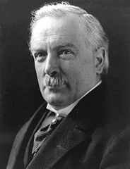
PERSPECTIVES of the Treaty
Britain
Britain gained some German colonies and the German navy was destroyed but:
Lloyd George thought the treaty was too harsh, saying: "We shall have to fight another war again in 25 years time."
The British diplomat Harold Nicolson called it "neither just nor wise" and the people who made it "stupid".
The economist John Maynard Keynes prophesied that reparations would ruin the economy of Europe.

Slide 3
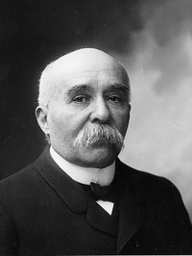
PERSPECTIVES of the Treaty
France
France got Alsace-Lorraine, German colonies, harsh reparations and a tiny German army but:
Many French people wanted an independent, not a demilitarised, Rhineland.
Most French people did not think the League of Nations would protect them against Germany.

Slide 4
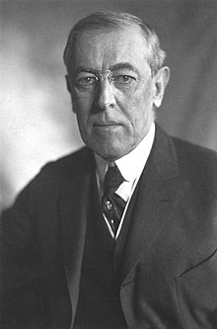
PERSPECTIVES of the Treaty
America
Woodrow Wilson got the League of Nations, and new nation-states were set up in Eastern Europe but:
Wilson thought the treaty was far too harsh.
Self-determination proved impossible to implement - neither Czechoslovakia or Yugoslavia survived as united countries.
Many Americans did not want to get involved in Europe, and in 1920 the American Senate refused to sign the Treaty of Versailles, or join the League of Nations.

